Slide 1
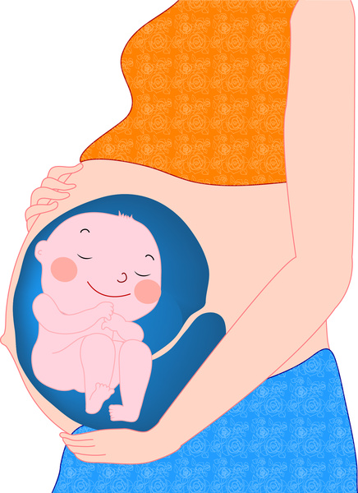
RSE Mummy’s Bump
Year 2

Slide 2
Questions for discussion
Who has a little brother or sister?
Can you remember your mummy being pregnant?
Do you know anyone who is pregnant now?
I bet you have lots of questions about what is going on in mummy’s tummy and how a baby grows….? Today we are going to talk all about where a baby lives before it is born.”

Slide 3
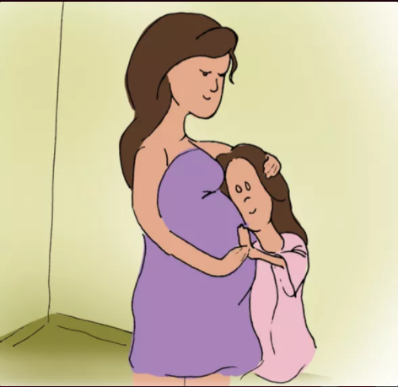
What is going on in this picture?
How can you tell?
Notes:
Allow the children time to respond and listen to their answers. Now introduce the lesson.
Ask the children to put their hands up if they have a little brother or sister… can they remember their mum being pregnant? Allow the children to tell their stories.
(be mindful of other options too such as foster and adopted siblings - it is an opportunity for their stories too.)

Slide 4
Where do babies live before they are born?
Notes:
Think, pair, share and listen to the children’s discussions.

Slide 5
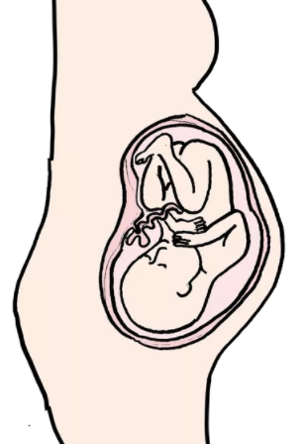
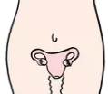
This is called a womb.
This is a stretchy sack
Like a balloon.
.
Notes:
“Before a baby is born it lives in a stretchy sack inside a mummy’s tummy. This sack is called a womb. This is a womb. It is inside a woman’s tummy just below her belly button. When she is pregnant the womb fills up with warm water to keep the growing baby nice and safe.

Slide 6
How do babies feed in mummy's tummy?
Notes:
Do you know why you have a belly-button…? that is how you were fed when you were in your mummy’s tummy. You see a baby doesn’t eat like we do… instead there is a special tube called the Umbilical cord, that attaches the baby to the walls of the mother’s womb - and through this the baby gets all it needs to grow directly through the mother’s body. When you are born it is cut and you are left with a belly button.

Slide 7
Do you know why you have a belly-button…? That is how you were fed when you were in your mummy’s tummy. You see a baby doesn’t eat like we do… instead there is a special tube called the Umbilical cord, that attaches the baby to the walls of the mother’s womb - and through this the baby gets all it needs to grow directly through the mother’s body. When you are born it is cut and you are left with a belly button.

Slide 8
How do babies grow?

Slide 9
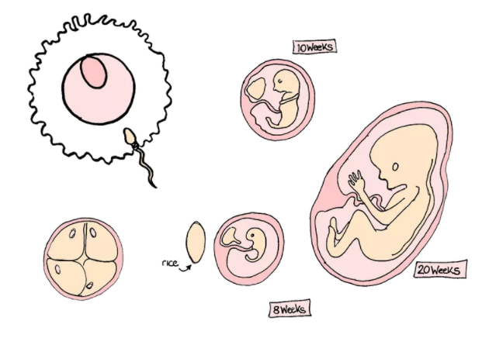
Notes:
Did you know it takes about 40 weeks - that’s 9 months for a baby to grow. But you can’t make a baby out of nothing - you need to start with something. Inside daddy's body he makes special cells called sperm cells. And inside mummy's body she makes special cells called egg cells. They each have half the instructions for making a baby. You need a sperm cell from daddy and an egg cell from mummy. When the sperm and egg cells meet they join together to make something new.
Sometimes, nothing happens….
But sometimes, it starts to grow - just like you did - into a baby.
Thank’s to all the food from the mother’s body it slowly get’s bigger and bigger and BIGGER AND BIGGER…
until it stops looking like a baked bean and now has fingers and toes and a nose and eyes and starts to kick its feet and wriggle around.
You will be able to feel it if you put your hand on mummy’s tummy and it will be able to hear you if you talk to it…
Ask the children if any of them have ever done this…

Slide 10
How do babies get out of mummy's tummy?
Notes:
Some babies let their mother know they are ready and other have to be helped out by a doctor. Sometimes it takes a long, long time and sometimes it is quite quick.
Most often babies are born by the mother pushing them out through the opening we call her vagina. The stretchy tunnel that leads from her womb to the outside - it is the opening hidden by her vulva that we have talked about. Sometimes this can hurt a lot as she will have to push and squeeze and her muscles will have stretch.
Sometimes doctors will make a special opening just below the mother’s belly button and take the baby out this way and then close up the whole again. We call this a cesarian - and you might have seen a line like a smiley face on mummy’s tummy where it has healed?

