Slide 1
Welcome to Year 1
Mrs Sinclair – Monday to Wednesday
Mrs Worth – Wednesday to Friday

Slide 2
Start of the Day
All parents and children must wait on the playground until 8:45 when the bell will ring.
The children then enter the door from the playground. Messages can be passed to the staff on the door.
Please do not allow your children on the playground equipment before or after school.
If you arrive after 9:00am, please report to the office and sign your child in there.

Slide 3
Rules and Rewards
Heathcote Primary has one school rule ‘Respect’.
House Points – every child is allocated a house and collects points for good work and behaviour.
Playground rules – red/yellow card
Please support us by helping us to reinforce the school rule – teachers are not in the habit of telling children off for no reason so please support us in our decisions so we can all work together to ensure all the children feel safe and happy at Heathcote.

Slide 4
General
If you need to speak to a teacher, please try to do so at the end of the day when there is more time obviously if it is urgent please contact the school office and I will get in touch as soon as I can.
Please name all school uniform and any equipment that the children would like to bring in to avoid losses. Please do not provide your children will large bags, the pegs in the classroom have limited space. Book bags are the best!
Uniform: children must wear their school uniform correctly, children also need to tie their hair up if it is shoulder length or longer. Please do not send your children in with big bows in their hair and earrings must be stud earrings.
The children are allowed to have a water bottle in the classroom. This can be refilled if needed.

Slide 5
Contacts
Twitter: You can keep up to date with what all the exciting things we are doing by following the class Twitter page
In addition there will also be a newsletter that will come home with children on a Friday.
At the beginning of each term you will also be provided with a curriculum map that outlines the exciting topics that the children will be learning about.
Another source of information is the school website, here there is a link to all our letters, twitter pages etc.
There will also be various class assemblies and the dates for these assemblies will be on the curriculum map.

Slide 6
P.E and Equipment
P.E is a statutory programme of study so all children must take part in P.E lessons.
P.E. kit: white top, white or black shorts, black pumps. P.E kits have to be in school all week.
If for any reason your child cannot participate in either of these please send your child in with a written note explaining why.
Letters will go home if children do not have suitable clothing and footwear.
PE days are Monday and Thursday

Slide 7
Homework
At Heathcote we value the partnership that we have with parents in supporting children's learning and development. We recognise and value the vital part parents play in their child's education. We believe that an effective partnership between the school and parents is essential and contributes to the success of our pupils. At the same time, we DO NOT believe in giving out lots of worksheets as homework – there is little evidence to show how this type of home learning supports your child’s progress.
Reading – It’s important that your child reads widely at home, every child at Heathcote Primary has a target to read every day e.g. This could be for a few minutes travelling home in the car, spending 5 minutes reading to an older sibling, reading and sharing a story book before bed. Each child will have a reading diary that will be checked and if we notice your child isn’t reading we will send a letter home to remind you of the schools targets. Please encourage your child to put their reading pack into the red box if they have completed their book and you have recorded in their book.

Slide 8
Power of Reading
We are extremely excited to have subscribed to a new English project called ‘The Power of reading’.
The Power of Reading is a school development project which engages teachers and children in the English curriculum through using high quality books and proven teaching approaches. The project offers multi-layered professional development drawing on Centre for Literacy in Primary Education's (CLPE's) highly regarded classroom-based research and experience of working with teachers. The Power of Reading project combines the use of outstanding books for teachers and children with an approach to teaching the English curriculum that is creative, engaging and develops a love of literacy.

Slide 9
Maths Mastery
Mathematics Mastery is a not-for-profit organisation. Their vision is for every child to enjoy and succeed in mathematics, regardless of background. Their Mission is to transform mathematics education in the UK. They work in partnership to empower and equip schools to deliver world-class mathematics teaching.
Mathematics Mastery schools want every child to succeed in maths, no matter what their backgrounds and starting points and we do believe at Heathcote that success in mathematics for every child is possible.
Maths Mastery is in practice about teaching fewer topics but in greater depth. Pupils are not going to be working through the curriculum more quickly, but going deeper into it.

Slide 10
School Trips
School trips are always educational and not just fun. We aim for one main trip but this could sometimes be two, normally with a coach cost each year but we also plan for excursions around the local area.
Unfortunately, if people do not pay for trips they may have to be cancelled.
However, if you are finding it difficult to pay for a trip please speak to the Head Teacher confidentially.
All trips should be paid via Parent Pay, please speak to the office if you need this to be set up.

Slide 11
Break times and Lunchtimes
Heathcote is a healthy eating school.
Children are provided every day with a healthy fruit snack at morning break,
There is also an opportunity for children to have a drink of milk each day but this will need to be ordered and paid for through the school office.
If children are having a school lunch, they choose their red, green or sandwich option at the beginning of the day.
Alternatively children are allowed to come in with their own packed lunch but please do not provide your children with any fizzy drinks, chocolate or sweets.

Slide 12
End of the Day
Parents are asked to wait outside the classrooms on the playground where the children will be dismissed at 15:15. Please do not come right up to the classroom windows in case the children are still learning as it can very distracting for the children.
When the classroom doors open please leave enough space for the teacher to see clearly who is collecting the children, this can be difficult if people are crowding the doors.
If somebody else is collecting your child, please can you inform the office or the class teacher and they will need to give the class teacher the password that you provided the school office with.
If you know you are going to be late picking your child up, please phone ahead and let us know as soon as possible.

Slide 13
SAFEGUARDING LEADERS
Mrs G Humphriss
Designated safeguarding Lead
Miss A Cowcher
Deputy Designated safeguarding Lead

Slide 14
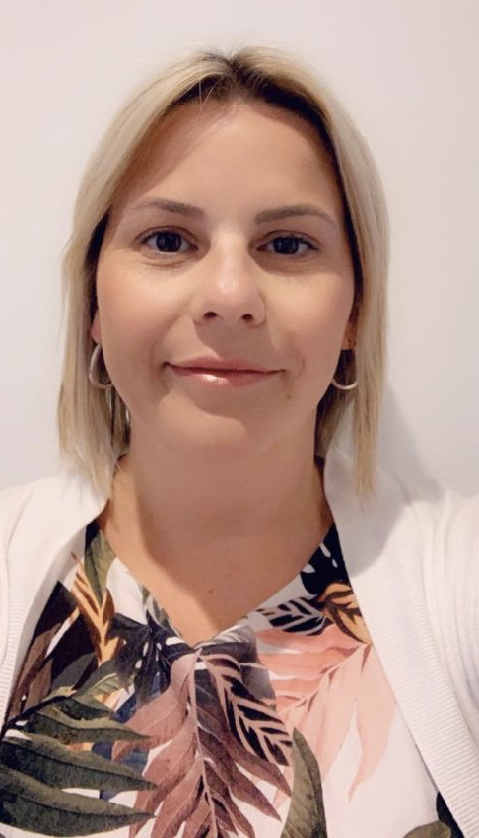
SAFEGUARDING LEADERS
Mrs A Mitchell
Deputy Designated safeguarding Lead
Mrs Abernethy
Deputy Designated safeguarding Lead

Slide 15
SAFEGUARDING
Safeguarding is everyone’s responsibility and the Safeguarding of your children is our highest priority
EVERY member of staff is trained in Safeguarding and kept up to date with all current government polices and procedures to ensure the safety of your children
If you have ANY concerns about the welfare of a child please talk to Mrs Humphriss or Miss Cowcher, or contact the MASH team directly on:01926 414144
If you have a concern about a member of staff regarding the safety of children then please discuss this with the Headteacher/DSL Mrs Humphriss, or Paul Wakeley, our chair of governors, whose contact details are available on the school website and are on posters around the school
We will be teaching your children about protective behaviours this term. This involves the children understanding their Early Warning signs, how they feel when things don’t feel right. It also provides them with the appropriate vocabulary to express themselves regarding what feels ok and what doesn’t.
Online safety is key and we will be teaching your children all about this every term.
Please look on our website for more online safety information for parents and other safeguarding information.

