Slide 1
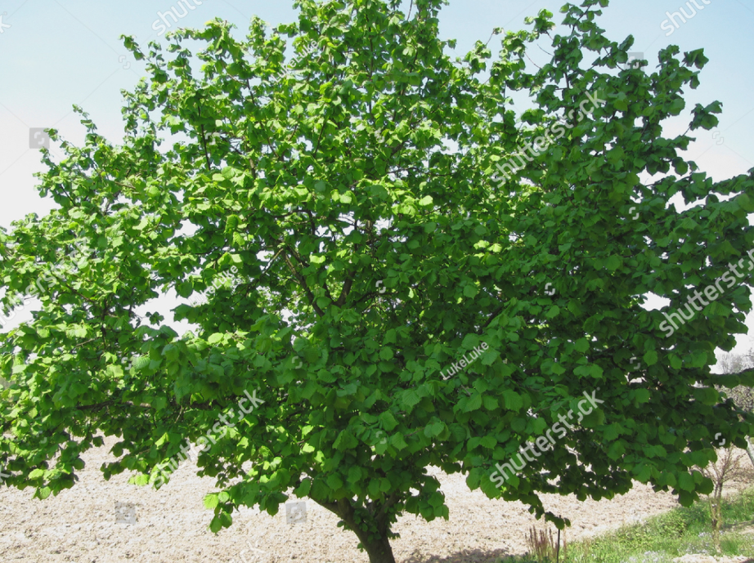
Welcome to Year 3 Hazel Class
Mr Whatson, Mrs Forest &
Miss Chadwick

Slide 2
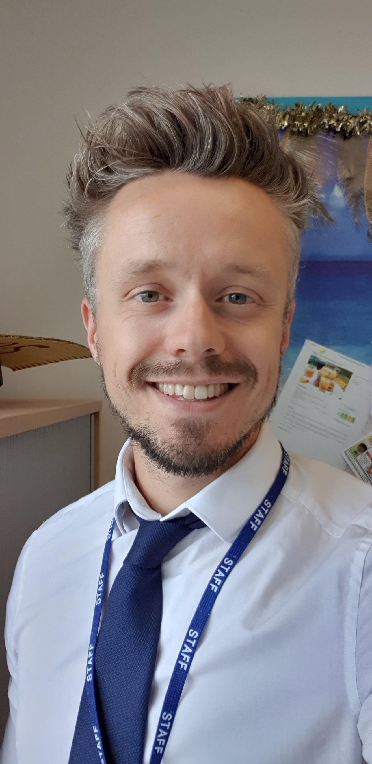
Meet your new teacher- Mr Whatson
Welcome to Hazel Class! My name is Mr Whatson and I will be your teacher next year. I am really looking forward to teaching you and getting up to some fun and exciting activities. We are going to be incredibly lucky next year, because we will hopefully be moving into the new part of the school after Christmas! ☺
Facts about Mr Whatson:
I love sports! All of them. Especially: football and going to the gym!
I play the drums and have been in many bands. Rock & Roll!
I love reading and can’t wait to share some great stories with you in our book corner!
I love food! All food. But aim to eat a balanced and healthy diet and not too much cake and chocolate ☹
I have a little boy called Woody, just like in Toy Story.

Slide 3
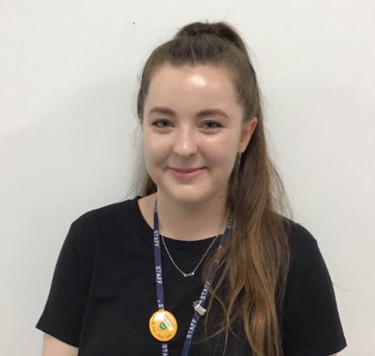
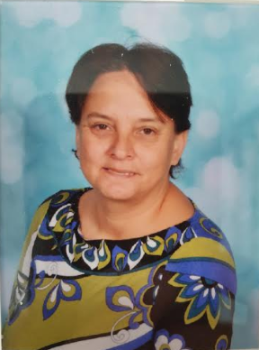
Meet our team
Miss Chadwick
Hi everyone ☺ I can’t wait to get to know you all really well and help with your learning in year 3. Here’s a little about me…
I love reading, Disney and dancing, and when I am not at school, you might find me as a Brownie leader or reading with a cup of tea. I too am scared of spiders though, so you might have to catch them for me!
My favourite subjects are English and Art.
Mrs Forrest
I am very excited about moving up with you to year 3. I know you all so well and I’m really pleased that I get to see you progress as much as you have done in another year!
I can’t wait to learn all about chocolate! I think this will be my favourite topic ☺
I’m a good artist and I look forwards to helping you create some magical art pieces.

Slide 4
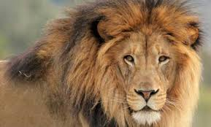
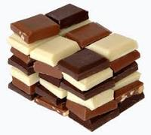
Learning in Year 3
We have got lots of exciting things planned for next year. We will be learning all about different animals and which ones are fearsome predators! If we’re lucky we might meet some birds of prey! We’ll be travelling back in time to investigate the origins of chocolate, harnessing our super powers to become superheroes and so much more. We will be diving into books, problem solving our way through maths, singing, dancing, painting, creating, investigating, exploring and much more!! We will all need a well deserved rest come Friday night!

Slide 5
What will our classrooms look like?
Our classroom will be the current year 3 classroom. Next door to the one you are in now. It will look fairly similar with a few changes.
After Christmas will be SO exciting for us, if all goes to plan, and the new building is finished, we will have to move all our things to our brand new classroom! ☺
You will sit in table groups and we will have a carpet space to help us with our learning.

Slide 6
Summer Project
As we have been unable to do our traditional ‘move up’ day we thought it would be nice if you could complete a couple of activities at home over the summer.
Activity 1: Create a ‘Who am I?’ poster – you could tell us about your favourite toys, food and games, what you like learning at school and what topics you are interested in. What do you want us to know about you? It would be great if you could also draw a self portrait.
Activity 2: Our class will be called Hazel Class. We will be the first Hazel Class in the whole school, ever! How exciting! I would like you to find a picture of a hazel tree and recreate it anyway you want. You can draw it, use paint, create it on the computer, use boxes and paper from around the house, you could even use materials outside, like sticks and leaves to create your picture.
We can use these to create our first classroom displays when we return in September.

Slide 7
Questions or Queries
We are happy to take any questions or queries you may have.
If you see us in school please do not hesitate to wave and say hello.
Parents can email our admin2056@welearn365.com address if they have any questions.
We are hoping to have a ‘Meet the Teacher’ session as soon as we can in the Autumn term.

