Slide 1
Welcome to Year 1 = Kingfishers and Otters
Mrs Shirley
Mrs Martin
Miss Kosminska
Mrs Sinclair/Mrs Worth

Slide 2
Start of the Day
Children can start coming into the classroom between 8:40am – 9:00am
The children will walk from the side gate and then enter through the external classroom doors.
Please keep to the one-way system, wear a mask and maintain a safe social distance from each other.
If you need to speak to the class teacher, please leave a message with the office or use the “Me to You” sheet.
If you arrive after 9:00am, please report to the office and sign your child in there.

Slide 3
General
Please name all school uniform and any equipment that the children would like to bring in to avoid losses. Please do not provide your children will large bags as everything is being kept on the children’s chairs.
Year 1 should arrive in the PE kit on Wednesday and Friday. PE lessons will take place both outside and inside, please make sure children are wearing suitable clothing.
Uniform: children must wear their school uniform correctly, children also need to tie their hair up if it is shoulder length or longer. Please do not send your children in with big bows in their hair and earrings must be stud earrings.
The children are allowed to have a water bottle in the classroom. This can be refilled if needed.

Slide 4
Continued…
Heathcote is a healthy eating school.
Children can bring a healthy snack to have at break time. There is also an opportunity for children to have a drink of milk each day but this will need to be ordered and paid for through the school office.
If children are having a school lunch, they choose their red, green, jacket potato or sandwich option at the beginning of the day.
Alternatively children are allowed to come in with their own packed lunch but please do not provide your children with any fizzy drinks, chocolate or sweets.
During break time and lunch time, each class has their own zoned area so they are not mixing between year groups.

Slide 5
Year 1 timetable

Slide 6
Year 1 topics
This term our topics are:
A copy of Year 1’s ‘Long Term Plan’ is available on the school website.
Through our curriculum we will be assessing and identifying any gaps in the children’s learning from the previous year due to school lock down period.
Here We Are | Animal Antics | Space Exploring

Slide 7
Formal assessments in Year 1
Children will be formally assessed in Phonics at the end of the year.
We have introduced a new scheme called Floppy’s Phonics this year. We shall be learning 3 new sounds per week.
In line with Floppy’s Phonics we have made the decision to come away from cursive writing on Year 1. We will be spending time modelling the new letter formations. If the children already has clear cursive handwriting then they can continue to use it.

Slide 8
E-schools
There will be weekly updates on the Kingfisher/Otters E-school page to support home learning for children who are off school for a prolong period of time due to self-isolating or shielding reasons.
The activities on E-school will reflect the learning taking place in school that week.
Children attending school do not need to complete any of the activities on E-school.
Children off from school can contact their class teacher via the e-school messaging systems.

Slide 9
Homework
At Heathcote we value the partnership that we have with parents in supporting children's learning and development. We recognise and value the vital part parents play in their child's education. We believe that an effective partnership between the school and parents is essential and contributes to the success of our pupils. At the same time, we DO NOT believe in giving out lots of worksheets as homework – there is little evidence to show how this type of home learning supports your child’s progress.
Instead, we will be sending out a new home learning sheet detailing some of the following week’s activities in school. Your child would benefit enormously from you discussing these with them during the week and helping us to practise new skills at home. In line with our homework policy, there is no worksheet style homework, however we do expect children to read daily, practice their times tables and learn spellings every week.
Reading – It’s important that your child reads widely at home, every child at Heathcote Primary has a target to read every day e.g. This could be for a few minutes travelling home in the car, spending 5 minutes reading to an older sibling, reading and sharing a story book before bed. Each child will have a reading diary that will be checked and if we notice your child isn’t reading we will send a letter home to remind you of the schools targets.

Slide 10
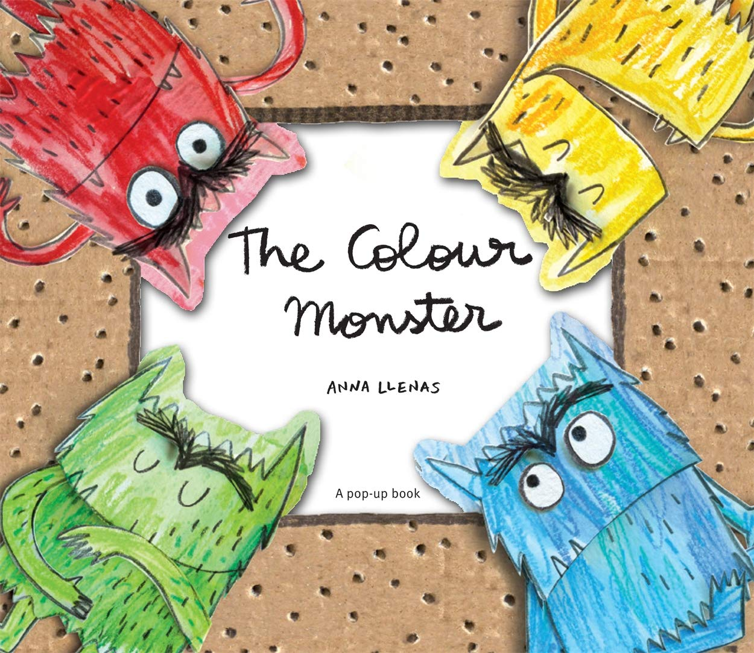
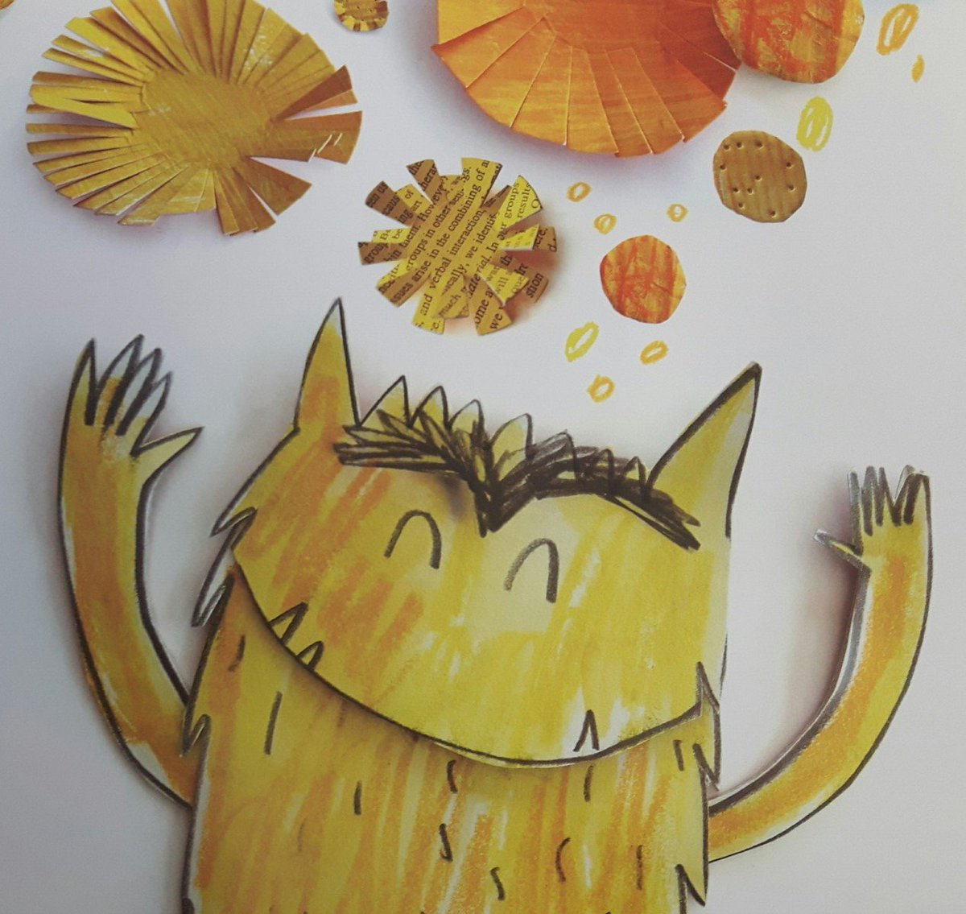
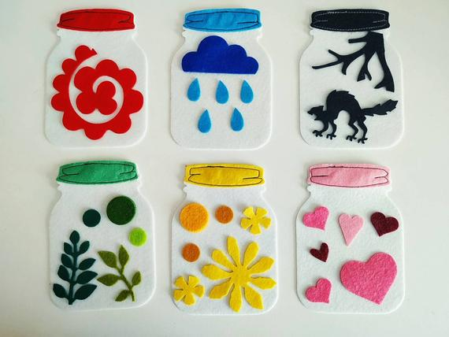
The Colour Monster
Our new curriculum provides opportunities for children to talk, reflect and understand their thoughts and feelings.
The Colour Monster story is being used across the school to support children understand how they are feeling and what they can do to help them feel happier and safer.
This is a good way to support children at home if they are struggling to express how they are feeling. Please take a jar sheet home to complete with your child if you would to.

Slide 11
Rules and Rewards
Heathcote Primary has one school rule ‘Respect’.
House Points – every child is allocated a house and collects points for good work and behaviour. House points across the school will be collected on a weekly basis.
Positive praise
Please support us by helping us to reinforce the school rule – teachers are not in the habit of telling children off for no reason so please support us in our decisions so we can all work together to ensure all the children feel safe and happy at Heathcote.

Slide 12
School Trips
School trips are always educational and not just fun. We aim for one main trip but this could sometimes be two, normally with a coach cost each year but we also plan for excursions around the local area.
Unfortunately, if people do not pay for trips they may have to be cancelled.
However, if you are finding it difficult to pay for a trip please speak to the Mrs Humphriss or Mrs Abernethy
All trips should be paid via Parent Pay, please speak to the office if you need this to be set up.

Slide 13
End of the Day
Pick up is between 3:00 – 3:20pm from the classroom doors. Kingfishers is the door nearest to the new building, Otters is the next one along.
Please remember to queue maintaining a social distance and next to the classroom window so other parents for different classes can pass safely by.
If somebody else is collecting your child, please can you inform the office or the class teacher and they will need to give the class teacher the password that you provided the school office with.
If you know you are going to be late picking your child up, please phone ahead and let us know as soon as possible.

Slide 14
Contact
Twitter: You can keep up to date with what all the exciting things we are doing by following the class Twitter page. #HEAYear1. We shall be continuing to use Tapestry too.
In addition there will also be a newsletter that will be sent via e-mail on a Friday.
At the beginning of each term you will also be provided with a curriculum map that outlines the exciting topics that the children will be learning about.
Another source of information is the school website, where there are links to all of our letters, calendar dates, twitter pages etc.

Slide 15
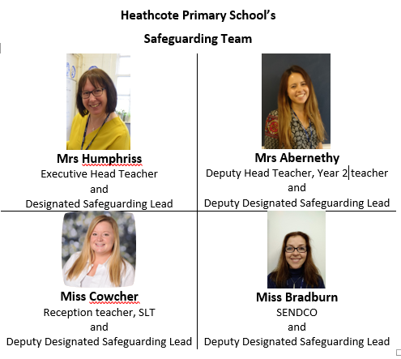
SAFEGUARDING LEADERS

Slide 16
SAFEGUARDING
Safeguarding is everyone’s responsibility and the Safeguarding of your children is our highest priority
Mrs Humphriss, Mrs Abernethy and Miss Bradburn are the safeguarding leads in the school
EVERY member of staff is trained in Safeguarding and kept up to date with all current government polices and procedures to ensure the safety of your children
If you have ANY concerns about the welfare of a child please talk to one of the school’s safeguarding leads, or contact the MASH team directly on:01926 414144
If you have a concern about a member of staff regarding the safety of children then please discuss this with the Headteacher/DSL Mrs Humphriss, Mrs Abernethy, or Paul Wakely, our chair of governors, whose contact details are available on the school website and are on posters around the school
We will be teaching your children about protective behaviours this term. This involves the children understanding their Early Warning signs, how they feel when things don’t feel right. It also provides them with the appropriate vocabulary to express themselves regarding what feels ok and what doesn’t.
Online safety is key and we will be teaching your children all about this every term.
Please look on our website for more online safety information for parents and other safeguarding information.

