Slide 1
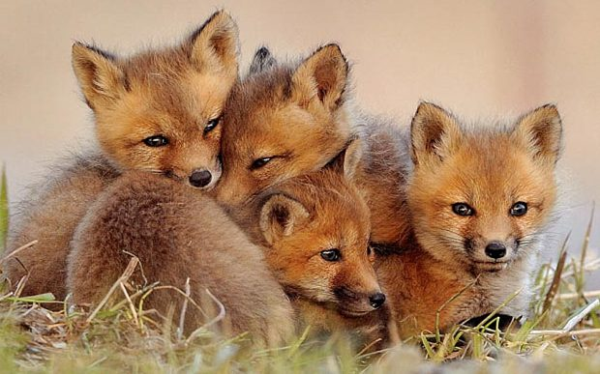
Welcome to Year 2
Mrs Shirley
The Foxes

Slide 2
Start of the Day
All parents and children must wait on the playground until 8:45 when the bell will be rung.
The children then enter the door next to the classroom.
f you urgently need to speak to the class teacher before 8:45, please go to the office to see if they are available.
Please do not allow your children on the playground equipment before or after school.
If you arrive after 9:00am, please report to the office and sign your child in there.

Slide 3
Rules and Rewards
Heathcote Primary has one school rule ‘Respect’.
House Points – every child is allocated a house and collects points for good work and behaviour.
Playground rules – red/yellow card
Please support us by helping us to reinforce the school rule – teachers are not in the habit of telling children off for no reason so please support us in our decisions so we can all work together to ensure all the children feel safe and happy at Heathcote.

Slide 4
General
If you need to speak to a teacher, please try to do so at the end of the day when there is more time obviously if it is urgent the teacher will be happy to speak in the morning before school.
Please name all school uniform and any equipment that the children would like to bring in to avoid losses. Please do not provide your children will large bags, the pegs in the classroom have limited space. Book bags are the best!
Uniform: children must wear their school uniform correctly, children also need to tie their hair up if it is shoulder length or longer. Please do not send your children in with big bows in their hair and earrings must be stud earrings.
The children are allowed to have a water bottle in the classroom. This can be refilled if needed.
Children can have pencil cases, which will be kept in their trays. All items should be be named.

Slide 5
Contacts
Twitter: You can keep up to date with what all the exciting things we are doing by following the class Twitter page … Foxes is coming soon!
In addition there will also be a newsletter that will come home with children on a Friday.
At the beginning of each term you will also be provided with a curriculum map that outlines the exciting topics that the children will be learning about.
Another source of information is the school website, here there is a link to all our letters, twitter pages etc.

Slide 6
P.E and Equipment
P.E is a statutory programme of study so all children must take part in P.E lessons.
P.E. kit: white top, white or black shorts, black pumps. P.E kits have to be in school all week.
If for any reason your child cannot participate in either of these please send your child in with a written note explaining why.
Letters will go home if children do not have suitable clothing and footwear.

Slide 7
Homework
At Heathcote we value the partnership that we have with parents in supporting children's learning and development. We recognise and value the vital part parents play in their child's education. We believe that an effective partnership between the school and parents is essential and contributes to the success of our pupils. At the same time, we DO NOT believe in giving out lots of worksheets as homework – there is little evidence to show how this type of home learning supports your child’s progress.
Instead, we will be sending out a new home learning sheet detailing some of the following week’s activities in school. Your child would benefit enormously from you discussing these with them during the week and helping us to practise new skills at home. In line with our homework policy, there is no worksheet style homework, however we do expect children to read daily, practice their times tables and learn spellings every week.
Reading – It’s important that your child reads widely at home, every child at Heathcote Primary has a target to read every day e.g. This could be for a few minutes travelling home in the car, spending 5 minutes reading to an older sibling, reading and sharing a story book before bed. Each child will have a reading diary that will be checked and if we notice your child isn’t reading we will send a letter home to remind you of the schools targets.

Slide 8
School Trips
School trips are always educational and not just fun. We aim for one main trip but this could sometimes be two, normally with a coach cost each year but we also plan for excursions around the local area.
Unfortunately, if people do not pay for trips they may have to be cancelled.
However, if you are finding it difficult to pay for a trip please speak to the Head Teacher confidentially.
All trips should be paid via Parent Pay, please speak to the office if you need this to be set up.

Slide 9
Break times and Lunchtimes
Heathcote is a healthy eating school.
Children are provided every day with a healthy fruit snack at morning break,
There is also an opportunity for children to have a drink of milk each day but this will need to be ordered and paid for through the school office.
If children are having a school lunch, they choose their red, green or sandwich option at the beginning of the day.
Alternatively children are allowed to come in with their own packed lunch but please do not provide your children with any fizzy drinks, chocolate or sweets.

Slide 10
End of the Day
•Parents are asked to wait on the playground where the class will be brought out to be dismissed.
•The children will be dismissed one at a time by the teacher, please do not come and take your child from the line as it is important we see who each child leaves with. If somebody else is collecting your child, please can you inform the office or the class teacher and they will need to give the class teacher the password that you provided the school office with.
If you know you are going to be late picking your child up, please phone ahead and let us know as soon as possible.

Slide 11
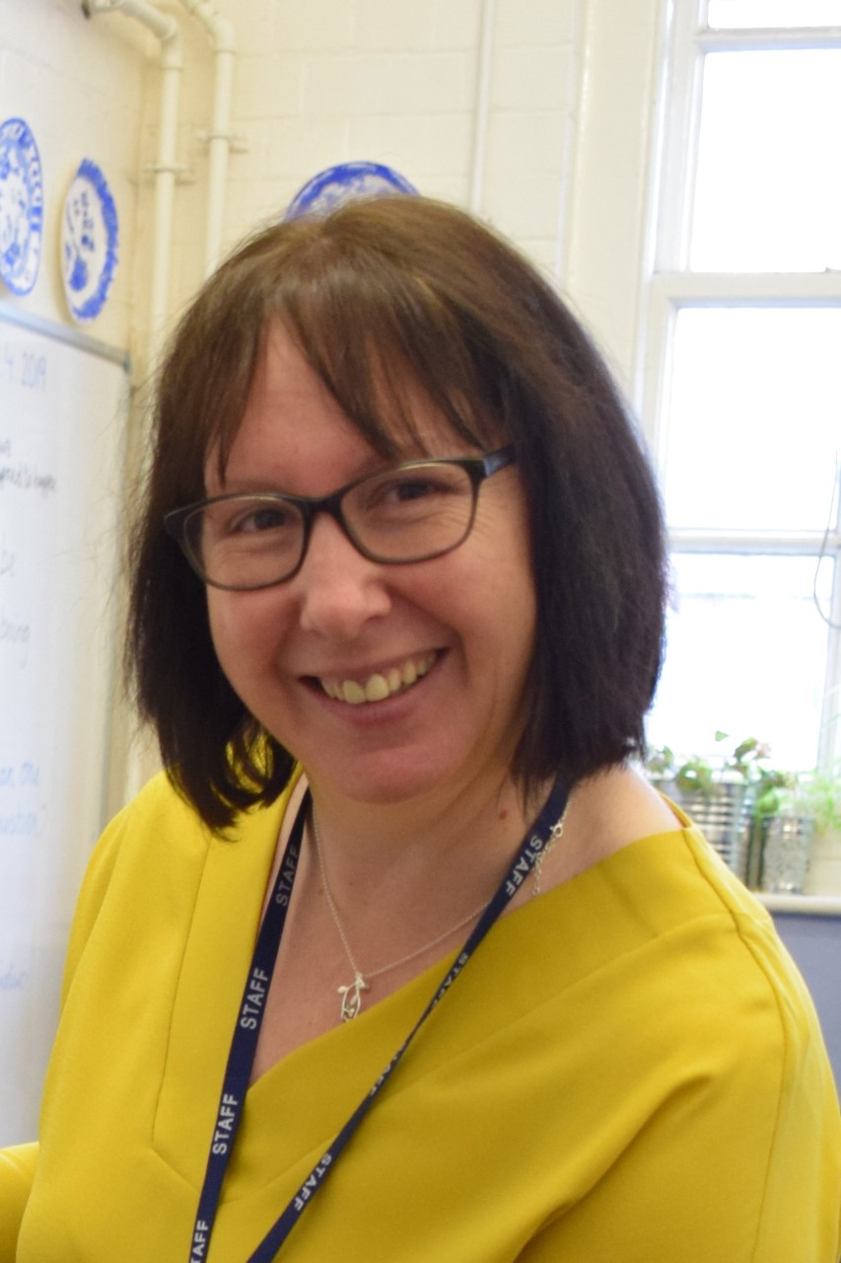
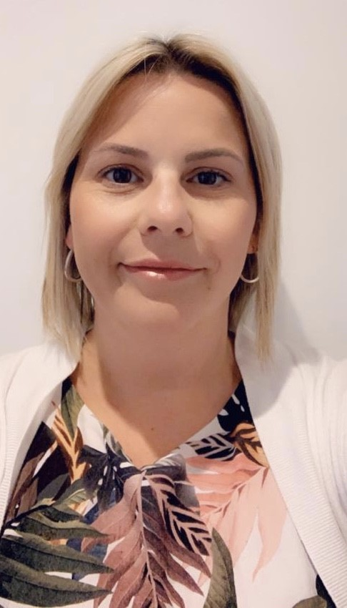
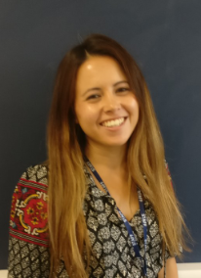
SAFEGUARDING LEADERS
Mrs G Humphriss and Mrs K Abernethy
Designated safeguarding Leads
Mrs A Mitchell and Miss A Cowcher ,
Deputy Designated safeguarding Leads

Slide 12
SAFEGUARDING
Safeguarding is everyone’s responsibility and the Safeguarding of your children is our highest priority
Mrs Humphriss, Mrs K Abernethy , Mrs A Mitchell and Miss A Cowcher are the safeguarding leads in the school
EVERY member of staff is trained in Safeguarding and kept up to date with all current government polices and procedures to ensure the safety of your children
If you have ANY concerns about the welfare of a child please talk to Mrs Humphriss, Mrs K Abernethy , Mrs A Mitchell or Miss A Cowcher , or contact the MASH team directly on:01926 414144
If you have a concern about a member of staff regarding the safety of children then please discuss this with the Headteacher/DSL Mrs Humphriss, Mrs Abernethy or Paul Wakeley, our chair of governors, whose contact details are available on the school website and are on posters around the school
We will be teaching your children about protective behaviours this term. This involves the children understanding their Early Warning signs, how they feel when things don’t feel right. It also provides them with the appropriate vocabulary to express themselves regarding what feels ok and what doesn’t.
Online safety is key and we will be teaching your children all about this every term.
Please look on our website for more online safety information for parents and other safeguarding information.

